Slide 1
FULL ASSEMBLEY OF VEHICLE MODEL

Slide 2
OBJECTIVES
Develop controller Plant model and Vehicle demand energy, Drive line, Battery, brake, motor, slave models of the vehicle In Simulink.
integrate plant and slave models to run the necessary drive cycles(City, Highway, Sc03, Us06) and validate the behavior.
Properly selecting Kp ,Ki ,and Kd values such that the actual vehicle velocity track the drive cycle velocity
Plots
Battery SOC vs time
Vehicle mph vs Driver Mph
Motor plots vs Vehicle Speed
Battery plots vs Vehicle Speed.

Slide 3
INPUTS
Total weight (lb)=4750;
Gravitational force= 9.81(m/s^2)
Air density=1.225 (kg/m3)
Frontal Area=1.8 (m^2)
Drag coefficient=0.2
Grade angle=15(deg)
Coefficient of rolling resistance=0.012
Gear ratio:7
Accessory load:600W
Open circuit voltage:345V
Internal resistance:0.1 ohm

Slide 4
HOW DO YOU DO?
Input variables are added in the MATLAB script in order to get that in work space.
Developed plant and slave models using Simulink blocks.
Imported the drive cycle data from MATLAB to Simulink using from workspace
Evaluated the plant and slave models model using scope and display blocks for error detection.
Adjust the Kp ,Ki ,and Kd values so that actual vehicle velocity track the Drive cycle velocity.
Adjust the values of different subsystem to check if actual velocity track the drive cycle.

Slide 5
US06 drive cycle is set as reference for modelling the velocity tracking.
After getting the result for US06 drive cycle , applied it for other drive cycles.

Slide 6
PID VALUES
Kp=300
Ki=10
Kd=0

Slide 7
US06 DRIVE CYCLE PLOTS

Slide 8
Overshoot (OS): 0.03%
Undershoot (US): NaN%
Settling Time (Ts): 541.00 seconds
Rise Time (Tr): 0.00 seconds
Peak Time (Tp): 33.50 seconds
Steady-State Error (Ess): 0.7728

Slide 9
SC03 DRIVE CYCLE PLOTS

Slide 10
Overshoot (OS): 0.04%
Undershoot (US): NaN%
Settling Time (Ts): 541.00 seconds
Rise Time (Tr): 0.00 seconds
Peak Time (Tp): 32.10 seconds
Steady-State Error (Ess): 0.0878
>>

Slide 11
CITY DRIVE CYCLE PLOTS

Slide 12
Overshoot (OS): 0.16%
Undershoot (US): NaN%
Settling Time (Ts): 538.20 seconds
Rise Time (Tr): 0.00 seconds
Peak Time (Tp): 55.10 seconds
Steady-State Error (Ess): 0.0602

Slide 13
HIGHWAY DRIVE CYCLE PLOTS

Slide 14
Overshoot (OS): 0.01%
Undershoot (US): Inf%
Settling Time (Ts): 686.80 seconds
Rise Time (Tr): 0.00 seconds
Peak Time (Tp): 42.20 seconds
Steady-State Error (Ess): 0.1317

Slide 15
US06 DRIVE CYCLE PLOTS :for Allowable regeneration 45%

Slide 16
US06 DRIVE CYCLE PLOTS :for Allowable regeneration 45%

Slide 17
SCO3 DRIVE CYCLE PLOTS :for Allowable regeneration 45%

Slide 18
SCO3 DRIVE CYCLE PLOTS :for Allowable regeneration 45%

Slide 19
HIGHWAY DRIVE CYCLE PLOTS :for Allowable regeneration 45%

Slide 20
HIGHWAY DRIVE CYCLE PLOTS :for Allowable regeneration 45%

Slide 21
CITY DRIVE CYCLE PLOTS :for Allowable regeneration 45%

Slide 22
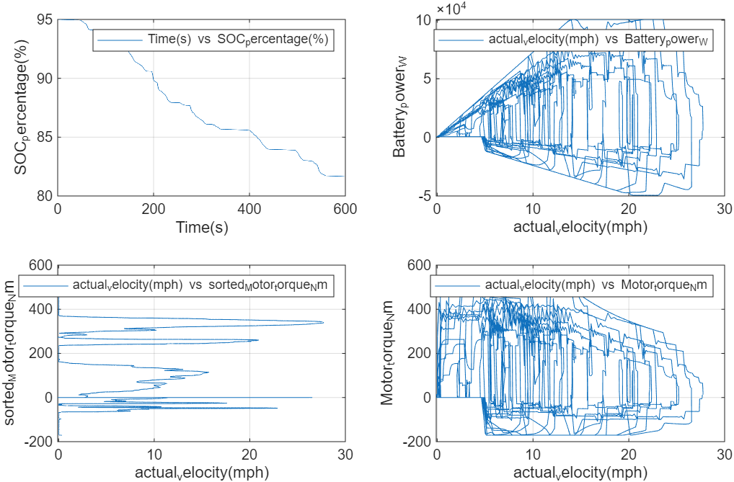
CITY DRIVE CYCLE PLOTS :for Allowable regeneration 45%

Slide 23
REFERENCES
https://in.mathworks.com/help/simulink/slref/busselector.html
https://in.mathworks.com/help/simulink/slref/buscreator.html
https://in.mathworks.com/help/aeroblks/velocityconversion.html

Slide 24
CONCLUSION
Adjusting tractive force along with PID can't achieve the actual velocity tracking with drive cycle, due to large resistive force.
While running the model with the already given values, the actual velocity become constant after a particular velocity value. It doesn’t follow the drive cycle.
When velocity is included in the rolling resistance calculation the resulting actual velocity become negative that is vehicle moves backward. For different PID values.
Adjusting tractive force above the saturation limit results the actual velocity become constant after a particular velocity value. It doesn’t follow the drive cycle.

Slide 25
Velocity tracking is difficult due to the large resistive force. The gradient force contribute the large portion of total resistive force.
Vehicle test for drive cycles are done on a flat surface so there is no gradient force .Based on this condition I limited gradient force using a saturation block having value 246 N(assume, if there is any small gradient).This gives good velocity tracking, hence result.
In real case modelling we can’t adjust the resistive force for closely matching the velocity. In that case resistive force is kept constant and adjust motor, driveline model to get the required tractive force. Here I assume the vehicle is under test condition or moving in a flat surface.

Slide 26
Actual vehicle velocity follows all the (US06,SC03,HIGHWAY,CITY) drive cycles with the same value of PID tuning.
System responses for each drive cycles are with in the limit indicate that tracking is done good.
For all drive cycle the Battery power increases with increase in velocity due to power consumption and decreases when decelerating due to regenerative braking. The battery power is higher at higher velocity due to aerodynamic effect.
Motor torque increases as velocity increases and torque is reduced at lower velocity region.

Slide 27
Due to frequent acceleration and deceleration the city drive cycle (velocity vs Motor torque) and (velocity vs battery power out) is more messy. Highway drive cycle has less frequent acceleration and deceleration so the graphs are smooth.
When velocity increases the motor torque decreases and battery power consumption increases.
Level messiness from high to low in case of (motor torque, battery power) vs speed
CITY DRIVE CYCLE
↓
SCO3 DRIVE CYCLE
↓
US06 DRIVE CYCLE
↓
HIGHWAY DRIVE CYCLE

Slide 28
Battery SOC decreases with time for all drive cycles.

Slide 29
WHAT I UNDERSTOOD?
PID model(plant) and all other slave models like motor, battery ,drive line, brake, vehicle demand energy models together represent how EV behaves.
The vehicle model is done by individually designing each subsystem and then integrating them.
In this modelling velocity matching is focused and based on that how the motor ,brake ,drive line ,battery models behaves.

Slide 30
END

